Slide 1
MAJOR PROJECT PRESENTATION ON “DELHI BUS NAVIGATOR”
UNDER THE GUIDANCE OF Mr. H S BHATIA (PROJECT IN-CHARGE)
SUBMITTED BY
BITTOO
1302051010
COMPUTER ENGINEERING 6 TH SEM

Slide 2


Android Introduction

Slide 3

What is Android?
Android is a software stack for mobile devices that includes an operating system, middleware and key applications.

Slide 4
What is Android?
A software platform and operating system for mobile devices
Based on the Linux kernel
Developed by Google and later the Open Handset Alliance (OHA)
Allows writing managed code in the Java language
Unveiling of the Android platform was announced on 5 November 2007 with the founding of OHA

Slide 5
History of Android
Google acquired the startup company Android Inc. in 2005 to start the development of the Android Platform. The key players at Android Inc. included Andy Rubin, Rich Miner, Nick Sears, and Chris White.
In late 2007, a group of industry leaders came together around the Android Platform to form the Open Handset Alliance.
The Android SDK was first issued as an “early look” release in November 2007.
In September 2008 T-Mobile announced the availability of the T-Mobile G1, the first smartphone based on the Android Platform.
A few days after that, Google announced the availability of Android SDK Release Candidate 1.0.
In October 2008, Google made the source code of the Android Platform available under Apache’s open source license.

Slide 6
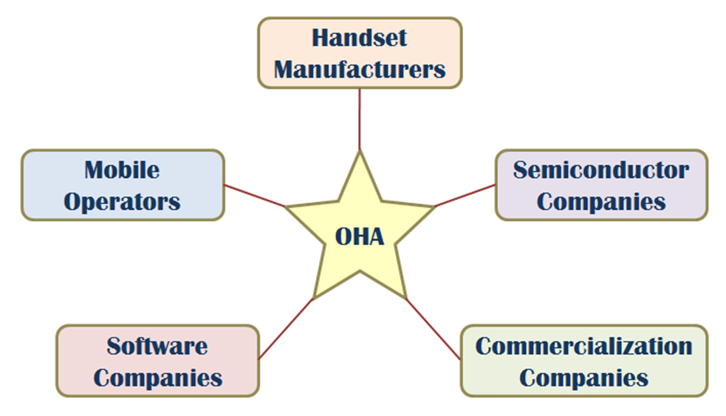
OHA (Open Handset Alliance)
A business alliance consisting of 47 companies to develop open standards for mobile devices

Slide 7
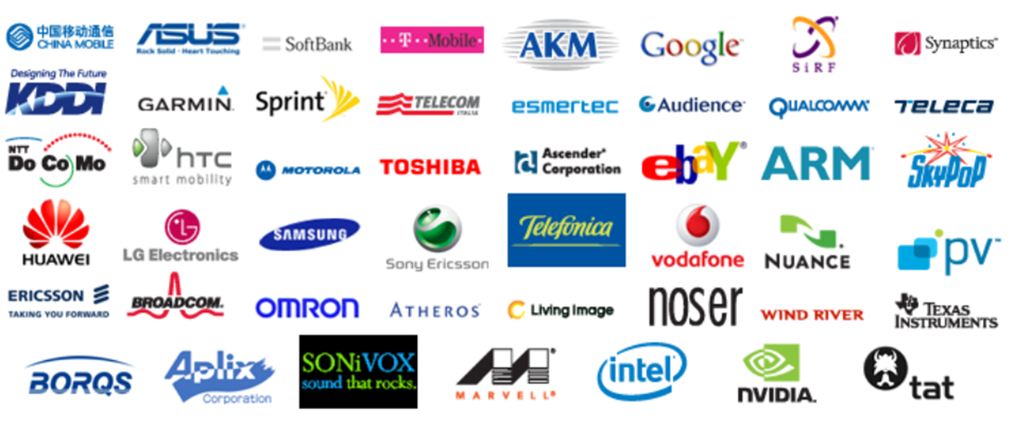
What is the Open Handset Alliance (OHA)?
“… Open Handset Alliance™, a group of 47 technology and mobile companies have come together to accelerate innovation in mobile and offer consumers a richer, less expensive, and better mobile experience.
Together we have developed Android™, the first complete, open, and free mobile platform.
We are committed to commercially deploy handsets and services using the Android Platform. “

Slide 8
Features of Android
Features | Description
Beautiful UI | Android OS basic screen provides a beautiful and intuitive user interface.
Connectivity | GSM/EDGE, IDEN, CDMA, EV-DO, UMTS, Bluetooth, Wi-Fi, LTE, NFC and WiMAX.
Storage | SQLite, a lightweight relational database, is used for data storage purposes.
Media support | H.263, H.264, MPEG-4 SP, AMR, AMR-WB, AAC, HE-AAC, AAC 5.1, MP3, MIDI, Ogg Vorbis, WAV, JPEG, PNG, GIF, and BMP
Messaging | SMS and MMS
Web browser | Based on the open-source WebKit layout engine, coupled with Chrome's V8 JavaScript engine supporting HTML5 and CSS3.

Slide 9
Features of Android
Features | Description
Multi-touch | Android has native support for multi-touch which was initially made available in handsets such as the HTC Hero.
Multi-tasking | User can jump from one task to another and same time various application can run simultaneously.
Resizable widgets | Widgets are resizable, so users can expand them to show more content or shrink them to save space
GCM | Google Cloud Messaging (GCM) is a service that lets developers send short message data to their users on Android devices, without needing a proprietary sync solution.
Wi-Fi Direct | A technology that lets apps discover and pair directly, over a high-bandwidth peer-to-peer connection.

Slide 10
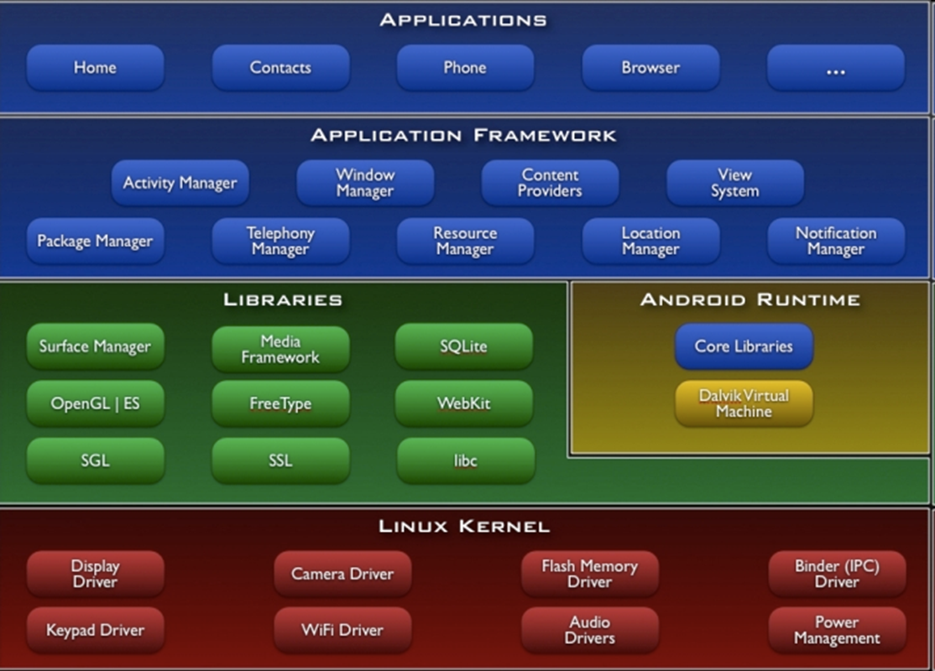
Architecture

Slide 11
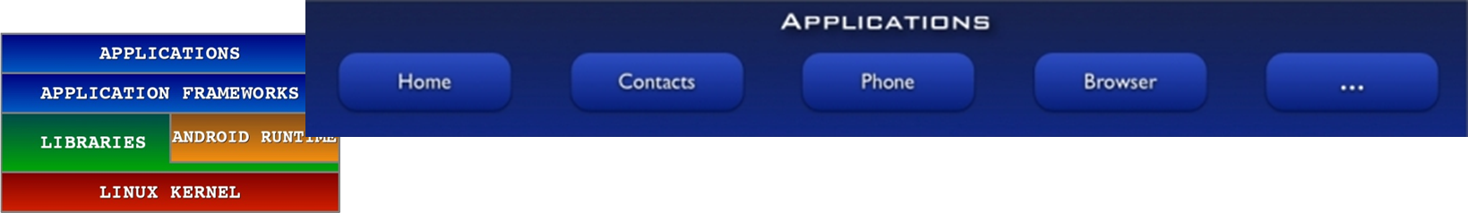
Android S/W Stack – application
your application to be installed on this layer only.
Android provides a set of core applications:
Examples :-
Contacts Books,
Browser,
Games
Email Client
SMS Program
Calendar
All applications are written using the Java language.

Slide 12
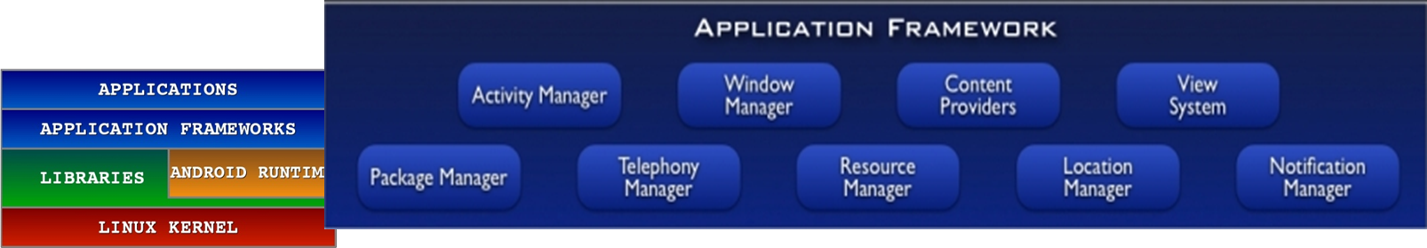
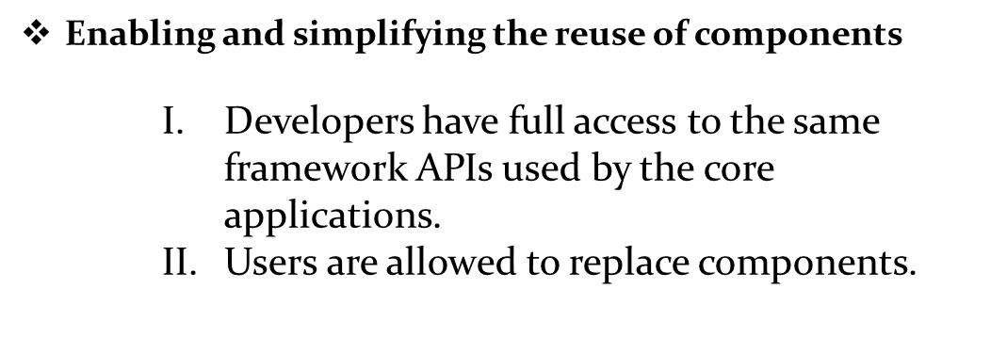
Android S/W Stack – App Framework
Manages the basic function of android device
EX;-
Resource Management
Voice call Management

Slide 13
Android S/W Stack – App Framework (Cont)
Feature | Role
View System | Used to build an application, including lists, grids, text boxes, buttons, and embedded web browser
Content Provider | Enabling applications to access data from other applications or to share their own data
Resource Manager | Providing access to non-code resources (localized string , graphics, and layout files)
Notification Manager | Enabling all applications to display customer alerts in the status bar
Activity Manager | Managing the activity lifecycle of applications and providing a common navigation backstack

Slide 14
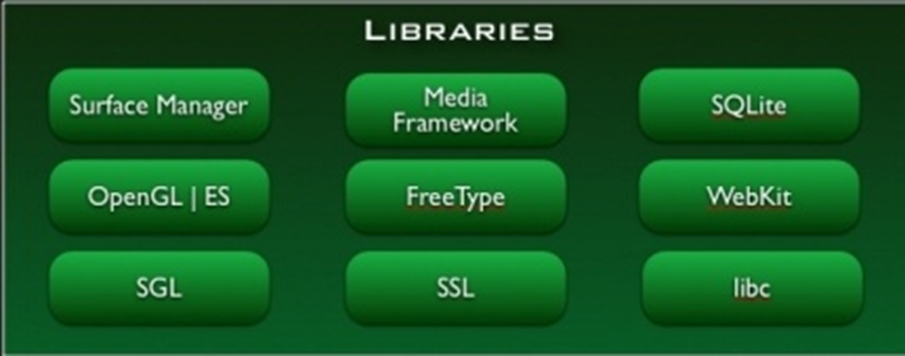
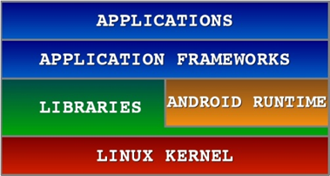
Android S/W Stack - Libraries
Including a set of C/C++ libraries used by components of the Android system
Exposed to developers through the Android application framework
libraries to play and record audio and video, SSL libraries responsible for Internet security etc.
A library called Surface Manager controls access to the display system and supports 2D and 3D.

Slide 15
Android S/W Stack - Libraries
Libraries | Explanation
SQLite | It is used to access data published by content providers & includes SQLite DB management classes.
SSL | It is used to provide internet security.
OpenGL | It is used to provide java interface to the OpenGL/ES3D graphics rendering API.
Webkit | It is the browser engine used to display internet content or HTML content.

Slide 16

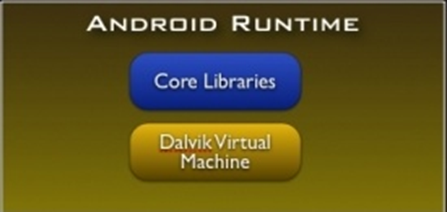
Android S/W Stack - Runtime
Core Libraries
Providing most of the functionality available in the core libraries of the Java language
APIs
Data Structures
Utilities
File Access
Network Access
Graphics
Etc

Slide 17
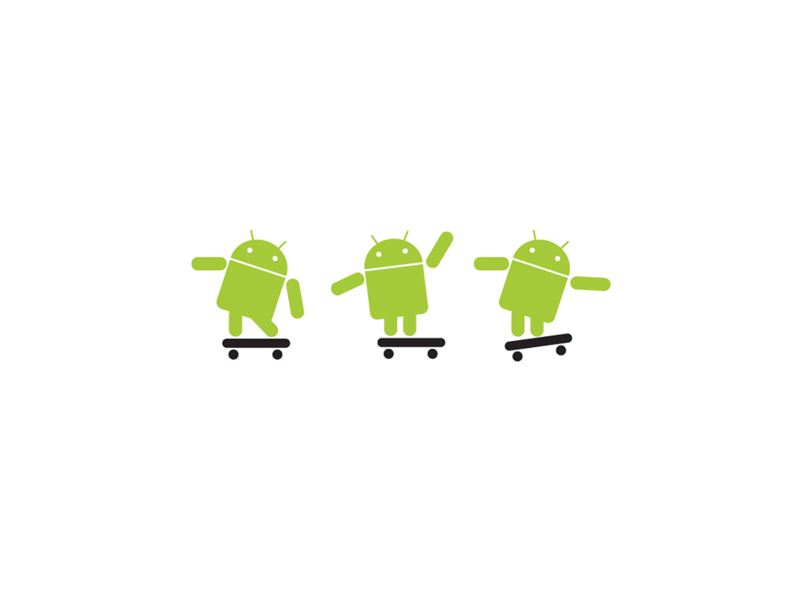
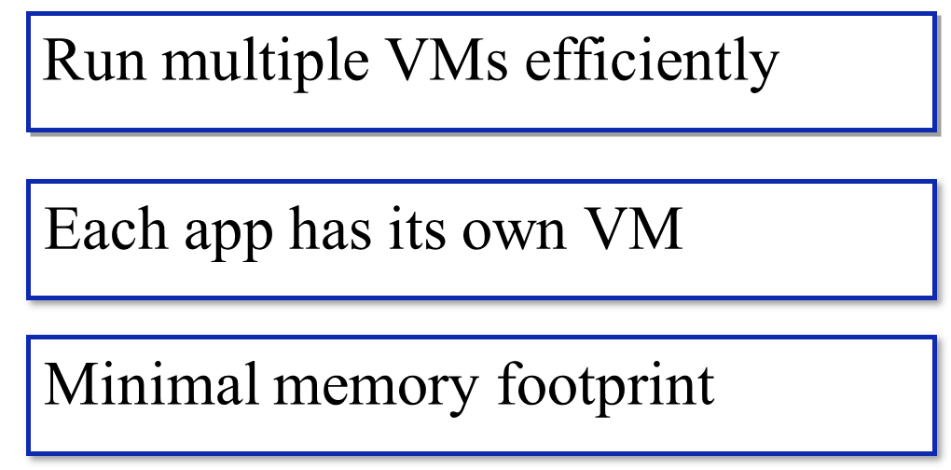
The Dalvik runtime is optimised for mobile applications

Slide 18
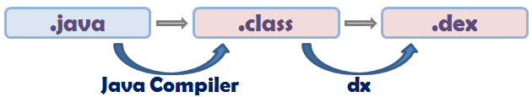
Android S/W Stack – Runtime (Cont)
Dalvik Virtual Machine (Cont)
Executing the Dalvik Executable (.dex) format
.dex format is optimized for minimal memory footprint.
Compilation

Slide 19
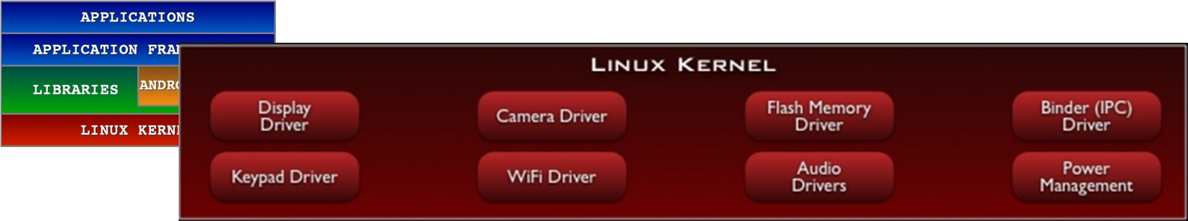
Android S/W Stack – Linux Kernel
Relying on Linux Kernel 2.6 for core system services
Memory and Process Management
Driver Model
Security
The supplied device drivers include Display, Camera, Keypad, WiFi, Flash Memory, Audio, and IPC (interprocess communication).
Providing an abstraction layer between the H/W and the rest of the S/W stack

Slide 20
Creating a Project (1)
STEPS(1):-
File -> New -> Project

Slide 21
Creating a Project (2)

Slide 22
Creating a Project (3)

Slide 23
Creating a Project (4)

Slide 24
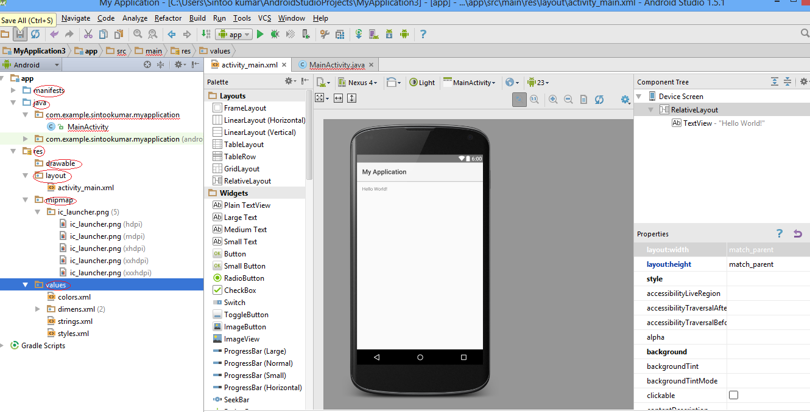
Project Components

Slide 25
Project Components
src – your source code
gen – auto-generated code (usually just R.java)
Included libraries
Resources
Drawables (like .png images)
Layouts
Values (like strings)
Manifest file

Slide 26
The Main Activity File
This is the actual application file which ultimately gets converted to a Dalvik executable and runs your application

Slide 27
XML

Slide 28
XML
Used to define some of the resources
Layouts (UI)
Strings
Manifest file
Separates the description of the layout from any actual code that controls it
Can easily take a UI from one platform to another

Slide 29
R Class
Auto-generated: you shouldn’t edit it
Contains IDs of the project resources
Enforces good software engineering
Use findViewById and Resources object to get access to the resources
Ex. Button b = (Button)findViewById(R.id.button1)
Ex. getResources().getString(R.string.hello));

Slide 30
The Manifest File
You must declare all its components in a manifest file called AndroidManifest.xml which resides at the root of the application project directory.
This file works as an interface between Android OS and your application,

Slide 31
Delhi Bus Navigator
PROBLEM STATEMENT
People love to travel places around. Whenever they get time, they visit the neighborhood, some heritage point, educational places, historical places, amusement parks etc. by the BUS.
There are lots of problem also arise :-
No internet connection
Google map
Time consuming
Costly

Slide 32
ADVANTAGES OF THE PROPOSED SYSTEM
Reduces the effort and time in gathering the information.
Provides a complete record.
Everything at single place.
No need to use Google and other internet apps simultaneously.
Categories according to type of the place.

Slide 33
INTRODUCTION
1. The phone should not lag each time any route or bus number has been requested for.
2. The platform used must be Android only.
3. All the bus numbers must be stored in the database and retrieved whenever asked for.
4. The application must have information about all the routes in Delhi.
5. The application must be updated with the addition of new buses along with the bus numbers as well as new routes.
6. The application must be user friendly enough for the user to understand it and operate it.
7. The application must not need internet while displaying only the routes. It must be done in offline mode.
8. The Android versions must support the application.

Slide 34
HARDWARE AND SOFTWARE REQUIREMENTS
HARDWARE REQUIREMENTS:
Processor : Intel i3 system/ Intel i5
Processor Speed : 2.1 GHz
RAM : 2 GB RAM
Hard Disk : 40GB
SOFTWARE REQUIREMENTS:
Operating System : Windows 7
Database : Sqlite
IDE : ECLIPSE JUNO ,ANDROID STUDIO

Slide 35
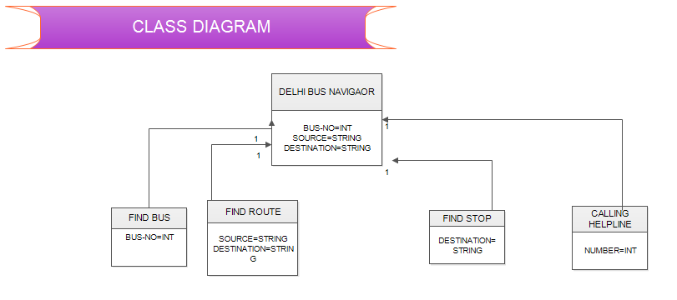
CLASS DIAGRAM

Slide 36
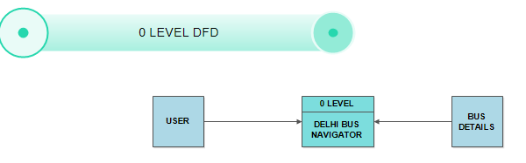
DATA FLOW DIAGRAM
O – LEVEL DFD

Slide 37
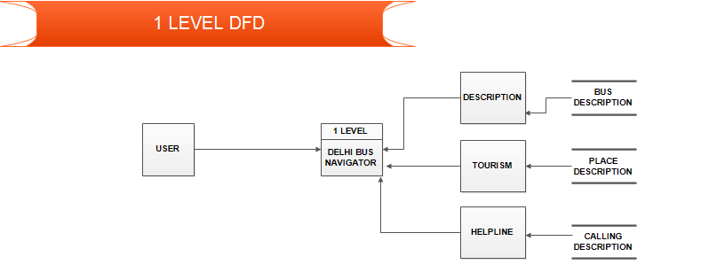
1 – LEVEL DFD
1 – LEVEL DFD

Slide 38
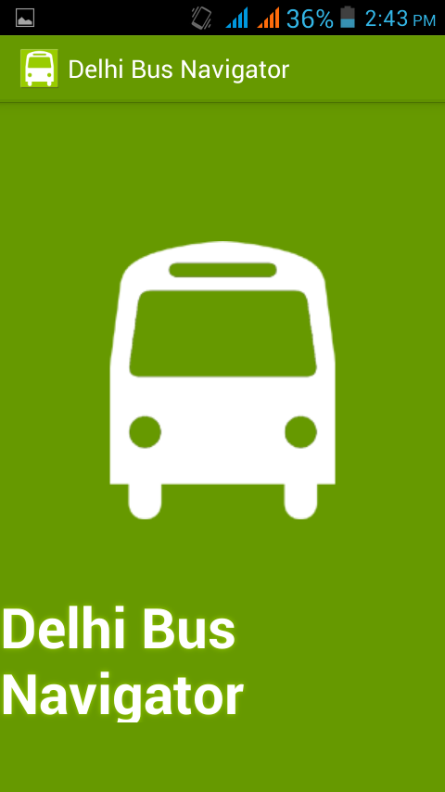
SCREEN SHOTS
WELCOME SCREEN

Slide 39
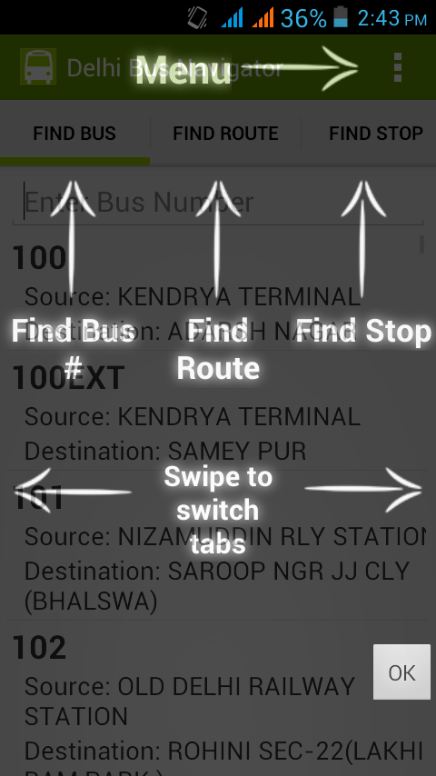
MENU

Slide 40
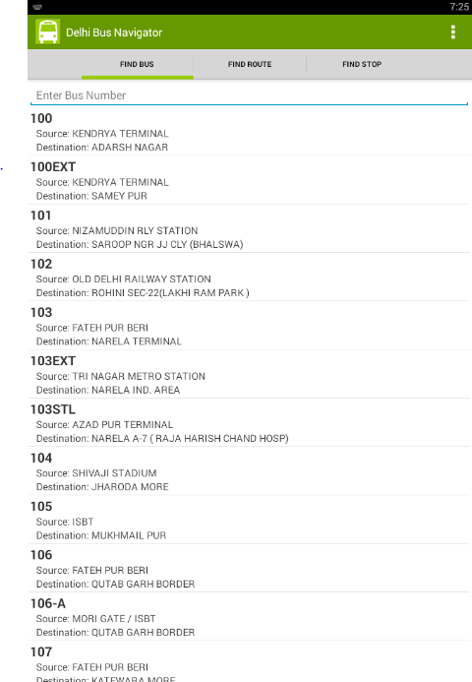
FIND BUS

Slide 41
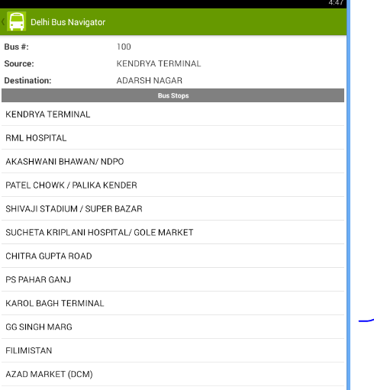
BUS DETAIL

Slide 42
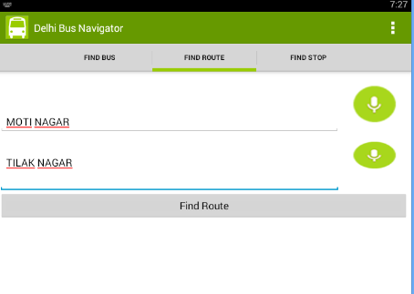
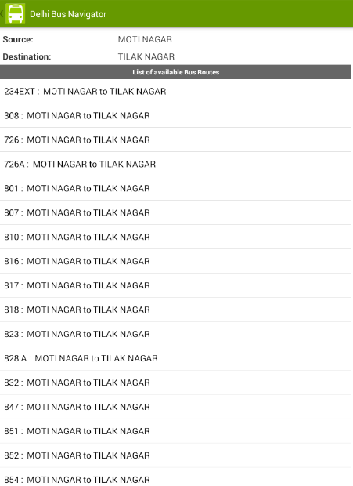
FIND ROUTE

Slide 43
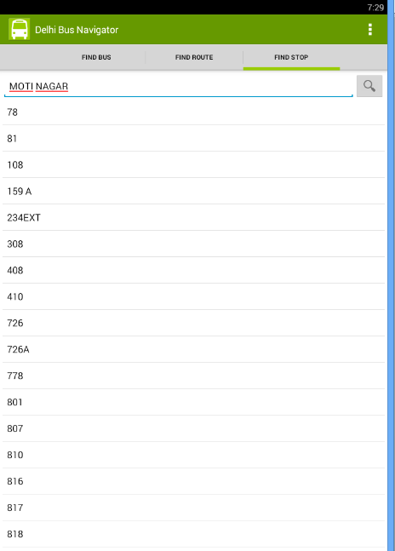
FIND STOP

Slide 44
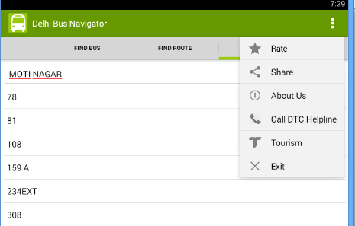
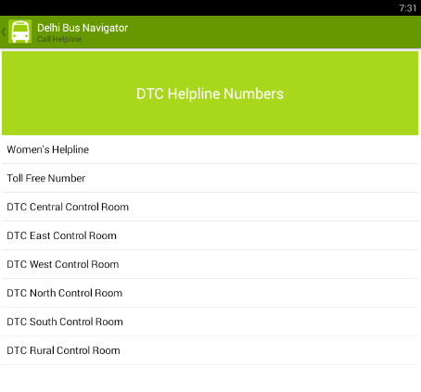
OTHER OPTIONS

Slide 45
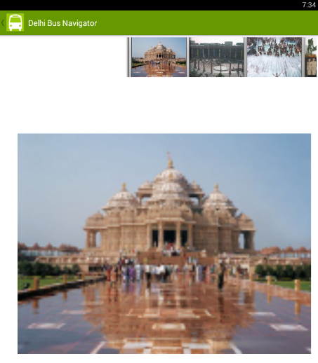
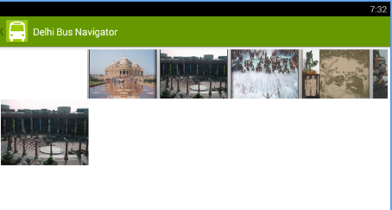
OTHER OPTIONS
TOURISM

Slide 46
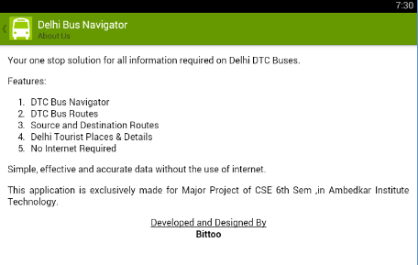
ABOUT US

Slide 47
BIBLOGRAPHY
http://www.google.com
http://www.youtube.com
http://www.wikipedia.com
http://www.microsoft.com

Slide 48


